Slide 1

Introduction to Gradient Boosting
Eoin Brazil, PhD, MSc
Proactive Technical Services, MongoDB
Github repo for this talk:
http://github.com/braz/pycon2016_talk/
Notes:
Hi I'm Eoin, I work with MongoDB in their proactive technical services team and I'm going to talk today about some learnings I found when looking into Gradient Boosting.
Gradient boosting is a very popular technique in Machine Learning and particularly so for competitions like those hosted by Kaggle. This talk will provide an introduction to the technique, a short historical recap and then focus on the existing libraries in Python that allow you to use this general family. It'll work through the advantages and disadvantage of specific libraries using worked examples. The code and slides will be in Github. The end learning of attendees will be sufficient knowledge to understand when to use this technique and what is the most appropriate Python library for their needs.

Slide 2
From Theory to Python Libraries

Slide 3
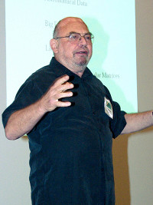


What this talk will cover
Leo Brieman
Jerome Friedman
Tianqi Chen
Notes:
Leo Brieman - his work on classification and regression trees and ensembles of trees fit to bootstrap samples. Bootstrap aggregation was given the name bagging by Breiman. Another of Breiman's ensemble approaches is the random forest.
Jerome Friedman – many ML contributions but specifically today, he’s one of the authors of Gradient Boosting
Tianqi Chen – xgboost author

Slide 4
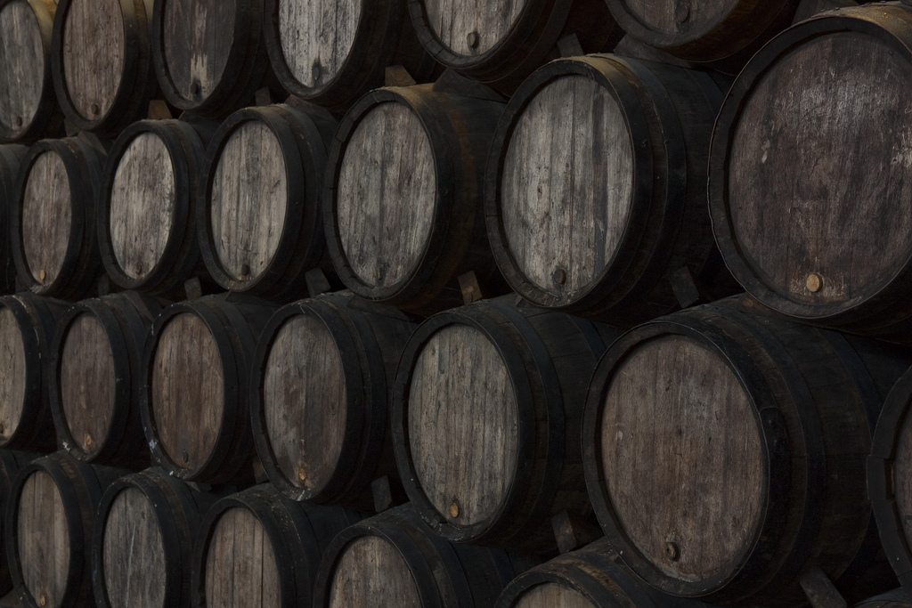
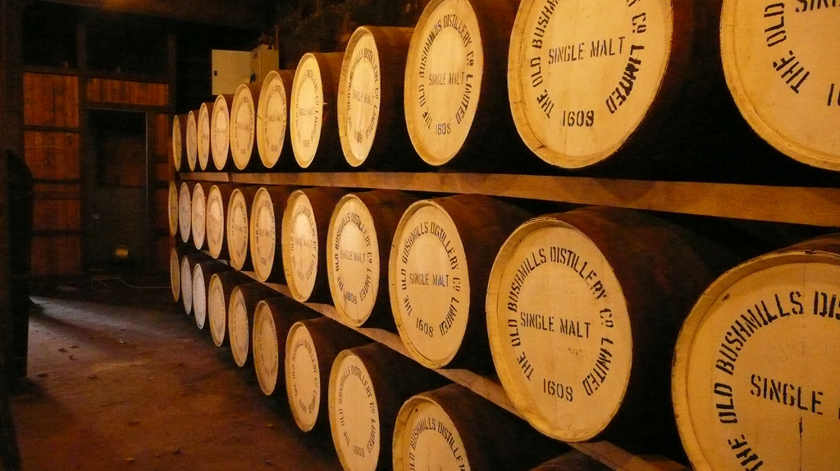
Types of Machine Learning

Slide 5


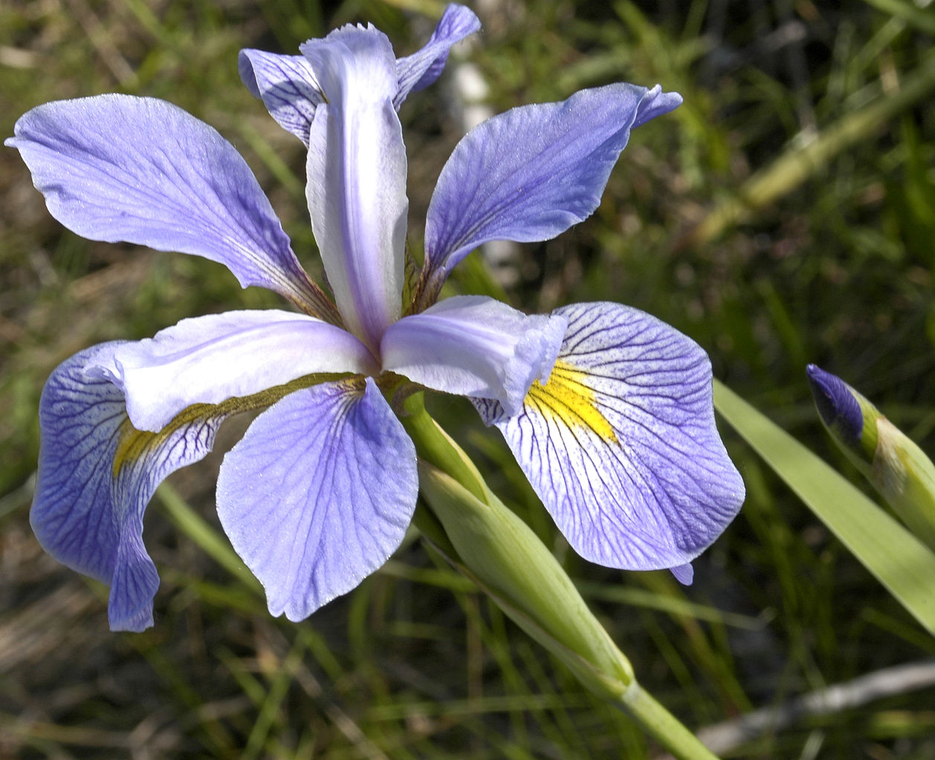
Iris Dataset
150 observations of 4 variable (sepal l/w and petal l/w)
Notes:
The Iris flower data set or Fisher's Iris data set is a multivariate data set introduced by Ronald Fisher in his 1936 paper The use of multiple measurements in taxonomic problems.

Slide 6
Supervised Techniques
Classification
Ranking
Regression
Notes:
Classification, the prediction is the class to which the data belongs
Regression, the prediction is a real number / value

Slide 7
Classification

Slide 8
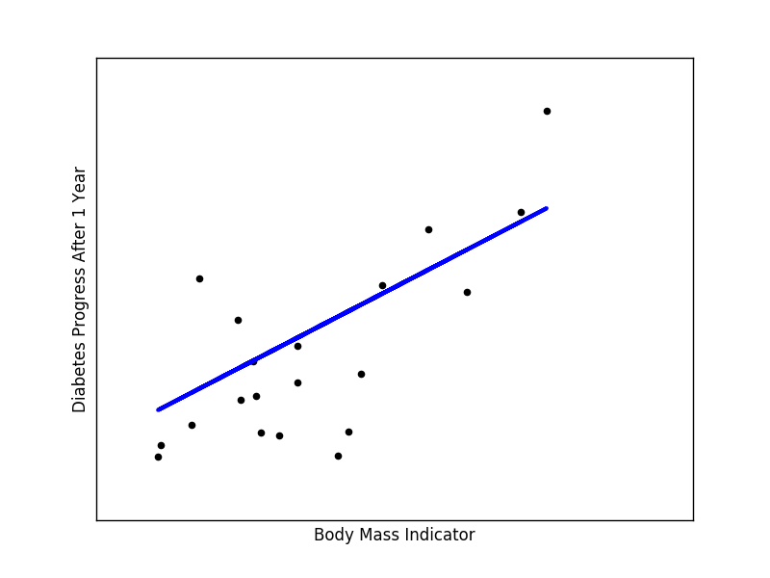
Regression
Notes:
In linear regression, the outcome (dependent variable) is continuous. It can have any one of an infinite number of possible values. In logistic regression, the outcome (dependent variable) has only a limited number of possible values. Logistic Regression is used when response variable is categorical in nature.

Slide 9
Context or a bit of history

Slide 10
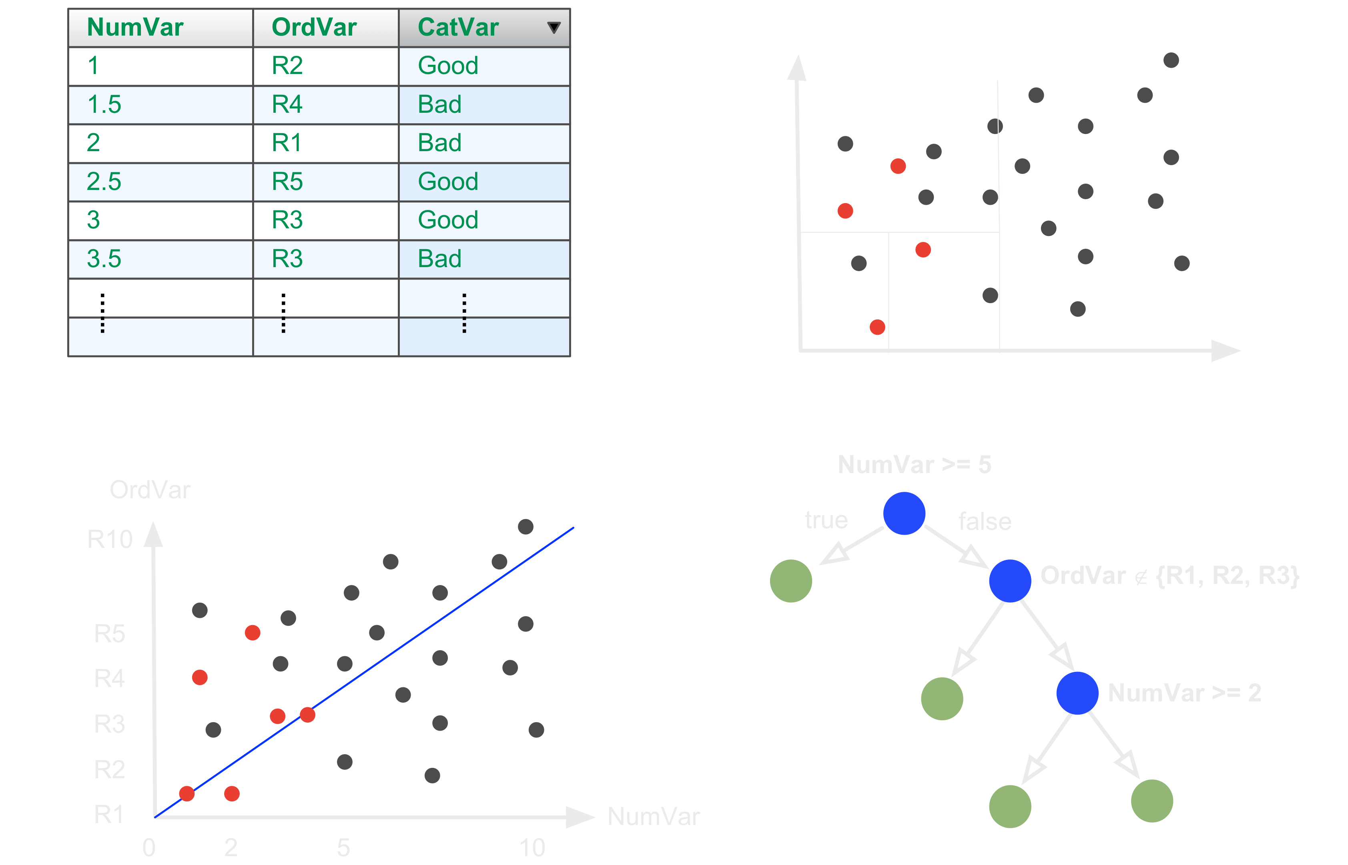
Decision Trees
Notes:
Decision tree learning uses a decision tree as a predictive model which maps observations about an item (represented in the branches) to conclusions about the item's target value (represented in the leaves). It is one of the predictive modelling approaches used in statistics, data mining and machine learning. Tree models where the target variable can take a finite set of values are called classification trees; in these tree structures, leaves represent class labels and branches represent conjunctions of features that lead to those class labels. Decision trees where the target variable can take continuous values (typically real numbers) are called regression trees.

Slide 11
Refining / Improving
Bagging
Boosting
Random Forests
Notes:
Bootstrap aggregating, also called bagging, is a machine learning ensemble meta-algorithm designed to improve the stability and accuracy of machine learning algorithms by combining classifications of randomly generated training sets. It also reduces variance and helps to avoid overfitting. Although it is usually applied to decision tree methods, it can be used with any type of method. Bagging is a special case of the model averaging approach (ensembles).
Boosting is a machine learning ensemble meta-algorithm for primarily reducing bias, and also variance in supervised learning, and a family of machine learning algorithms which convert weak learners to strong ones.
Generally, there is a tradeoff between bias and variance. A learning algorithm with low bias must be "flexible" so that it can fit the data well. But if the learning algorithm is too flexible, it will fit each training data set differently, and hence have high variance.
Random forest works by constructing a multitude of decision trees at training time and outputting the class that is the mode of the classes (classification) or mean prediction (regression) of the individual trees.

Slide 12
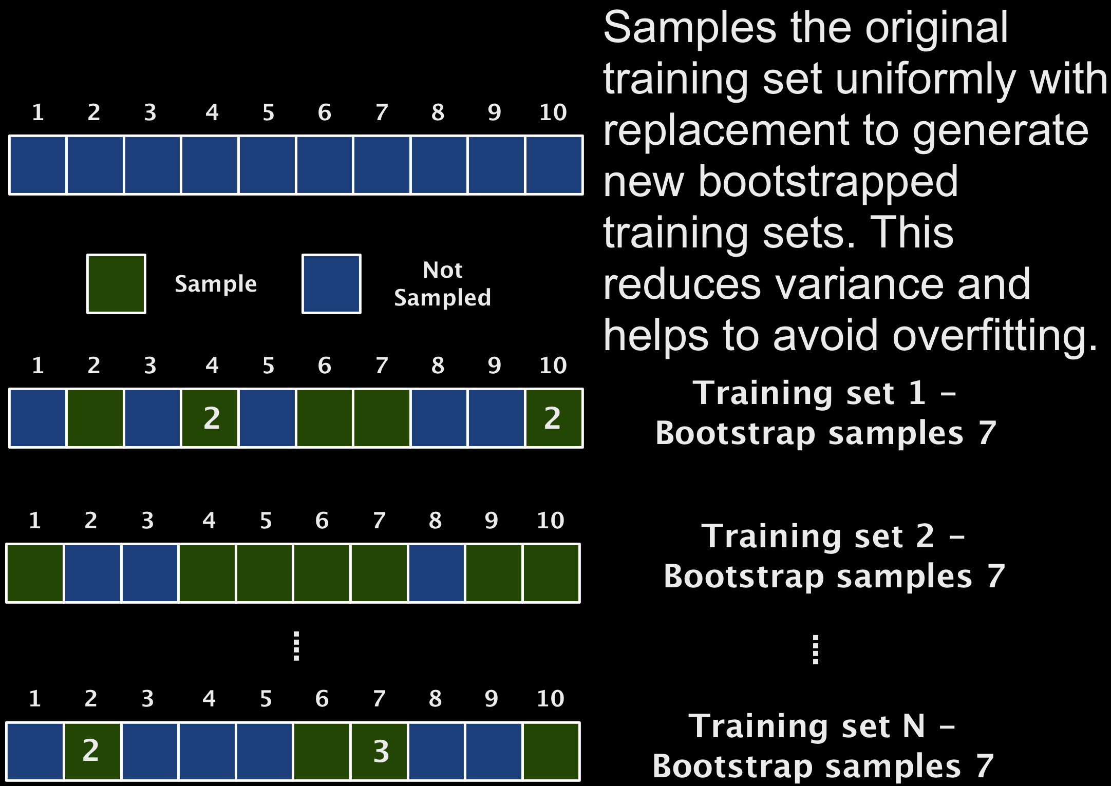
Bagging

Slide 13
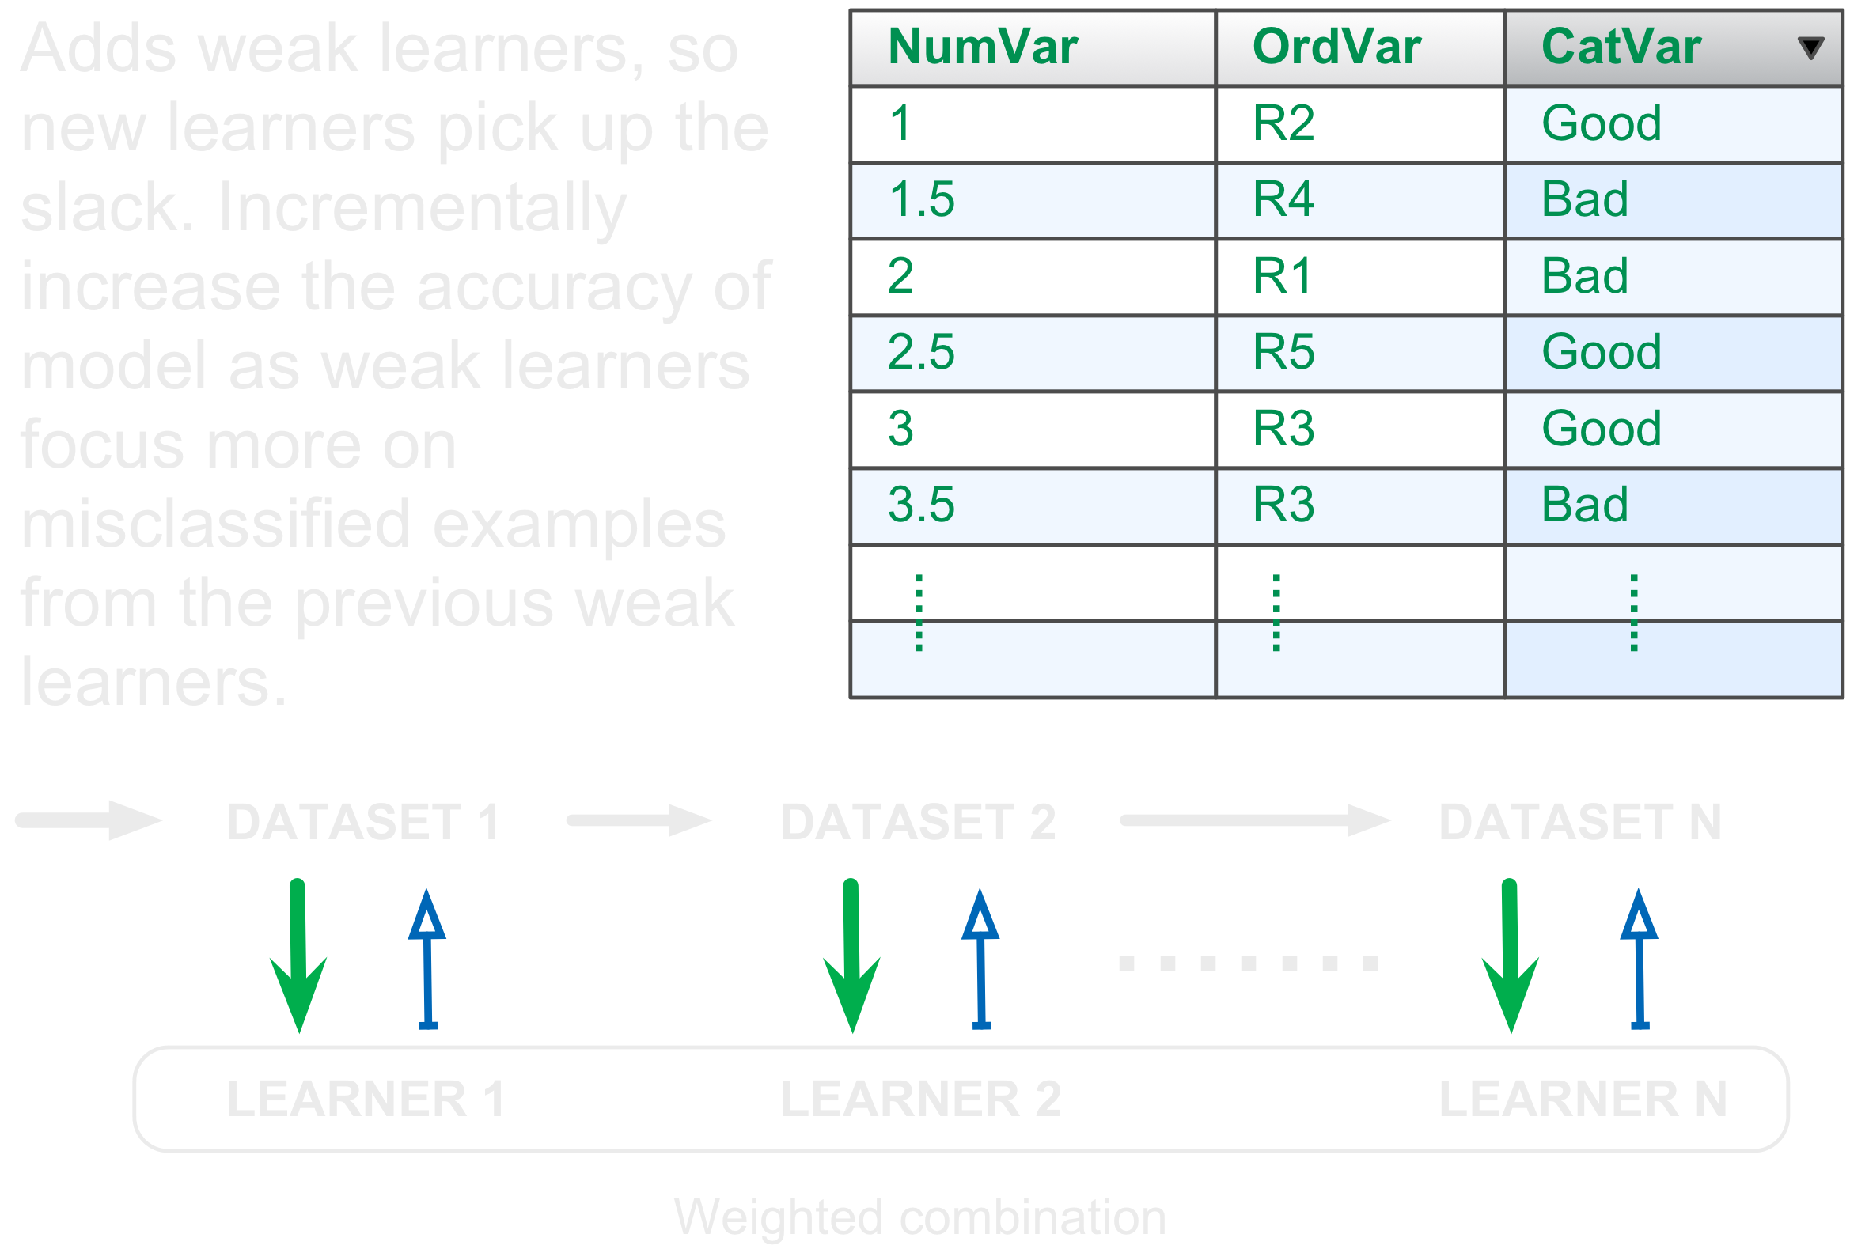
Boosting

Slide 14
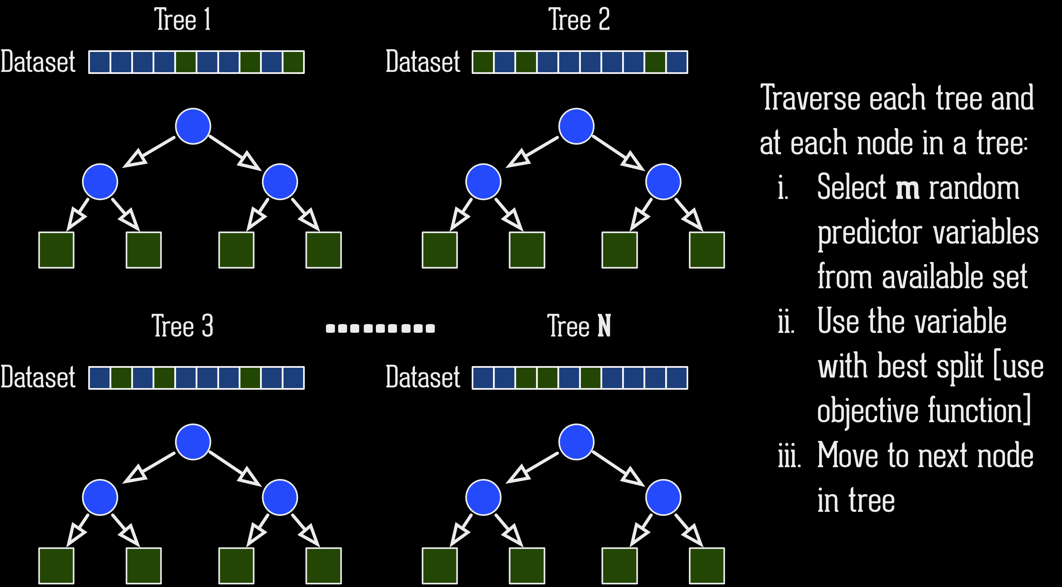
Random Forests
Notes:
Random forests or random decision forests are an ensemble learning method for classification, regression and other tasks, that operate by constructing a multitude of decision trees at training time and outputting the class that is the mode of the classes (classification) or mean prediction (regression) of the individual trees. Random decision forests correct for decision trees' habit of overfitting to their training set,

Slide 15
Gradient Boosting

Slide 16
Gradient Descent + Boosting

Slide 17
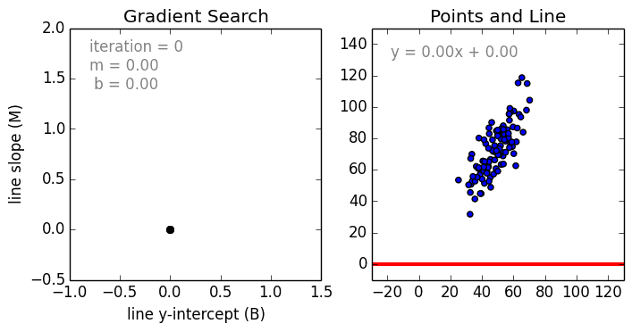
Gradient Descent
https://github.com/mattnedrich/GradientDescentExample
Notes:
Gradient descent is a first-order iterative optimization algorithm. To find a local minimum of a function using gradient descent, one takes steps proportional to the negative of the gradient (or of the approximate gradient) of the function at the current point. If instead one takes steps proportional to the positive of the gradient, one approaches a local maximum of that function; the procedure is then known as gradient ascent.

Slide 18
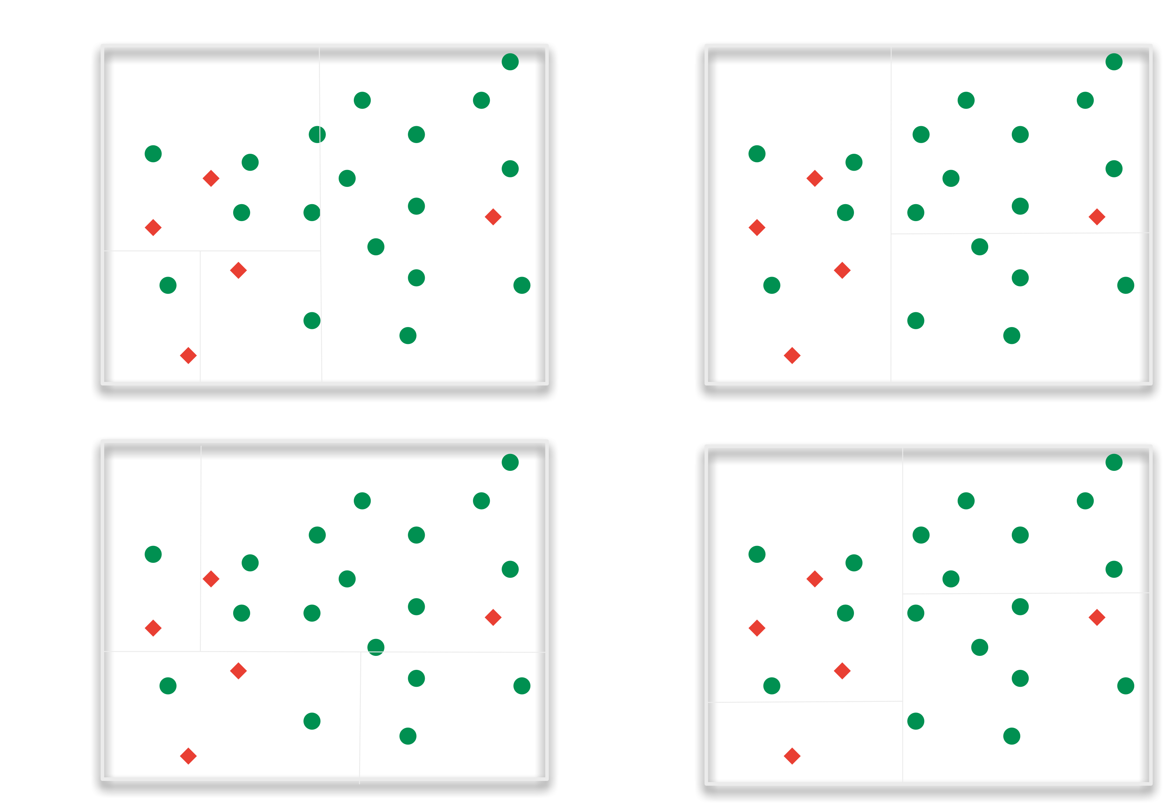
Gradient Boosting
Notes:
Each successor tree focus on the misclassifcations of the previous tree / learner in order to improve the classifcation

Slide 19
Tunables
Number of trees and the learning rate
Across all trees
subsampling rows
different loss function
Per tree
maximum tree depth
minimum samples to split a node
minimum samples in a leaf node
subsampling features

Slide 20

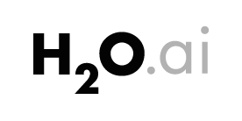



Slide 21
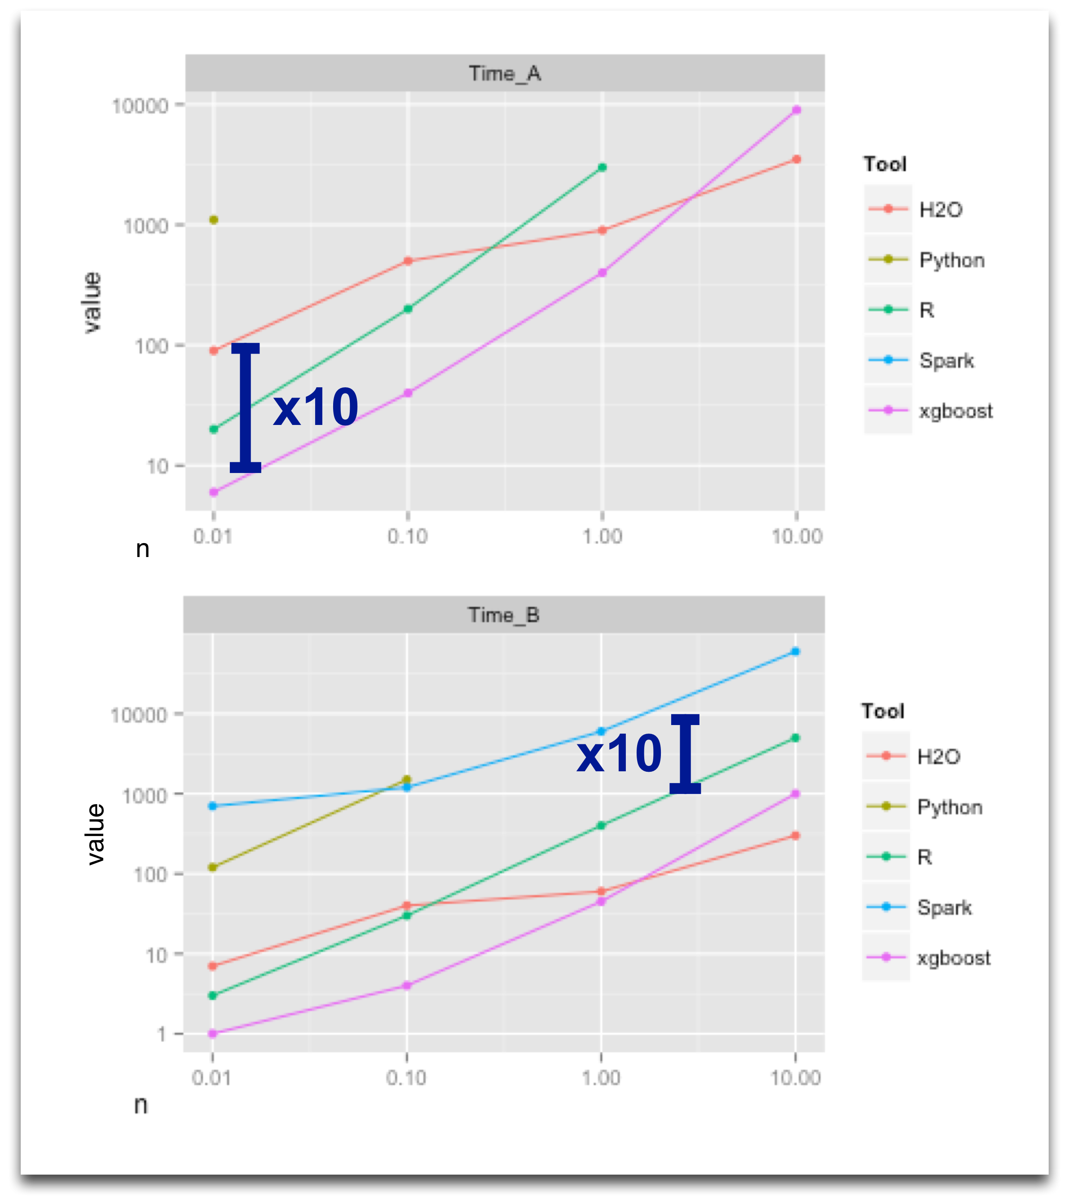
Which to choose ?
https://github.com/szilard/benchm-ml
7.5 hrs / 79.8 AUC H20
14 hrs / 81.1 AUC xgboost

Slide 22
Caveat for xgboost
Models by representing all problems as a regression predictive modeling problem and only takes numerical values as input.

Slide 23
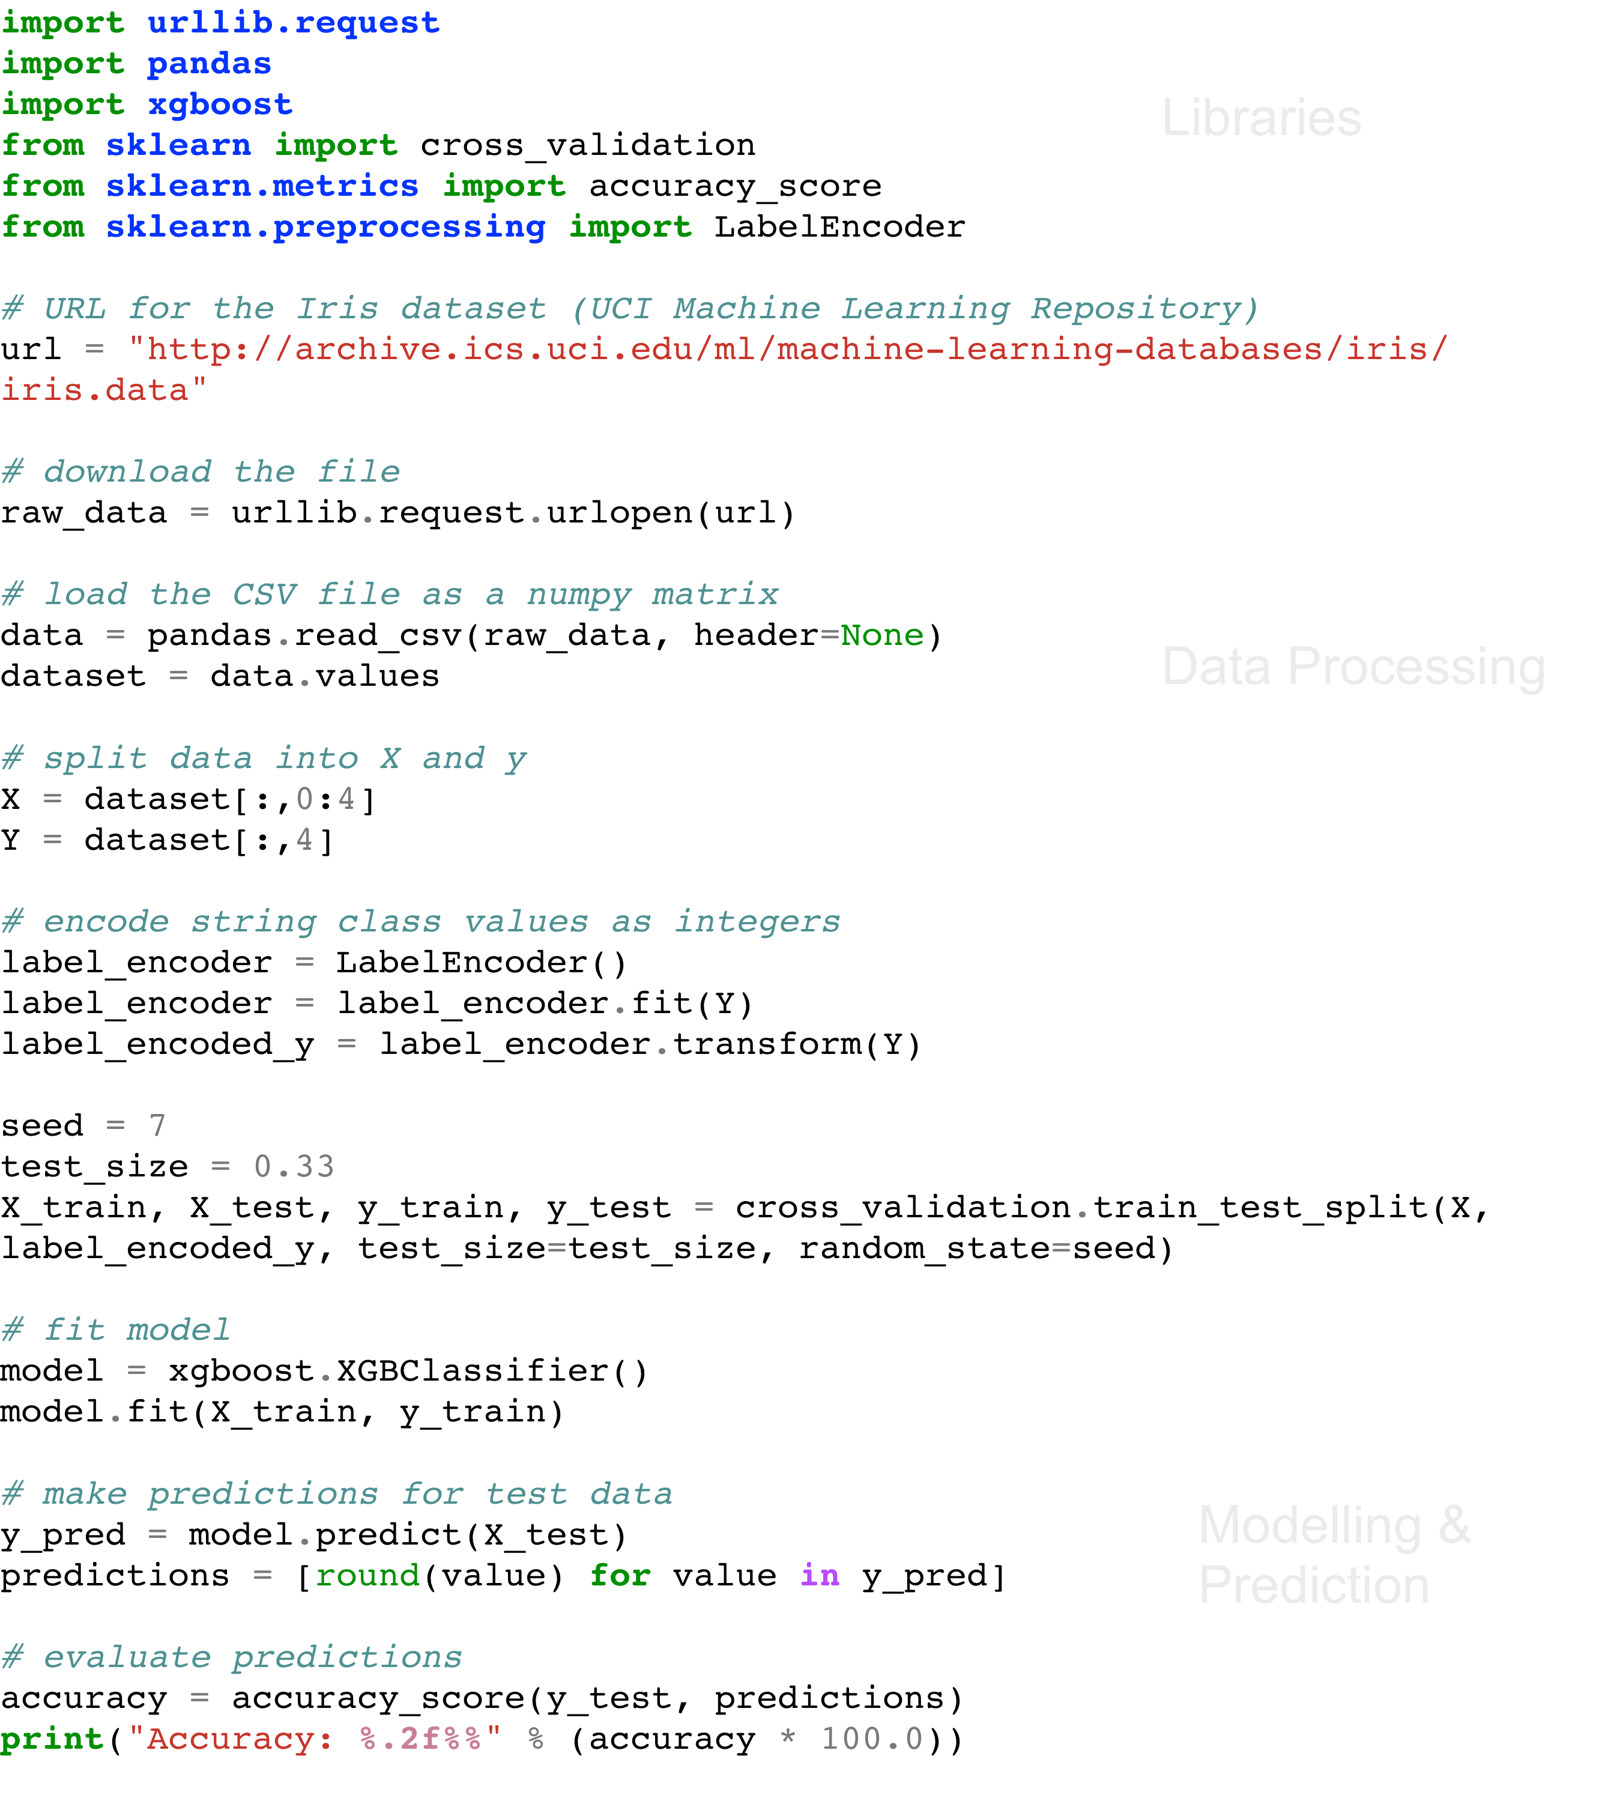
Notes:
Jump to Editor and CLI

Slide 24
A better example
import numpy as np
import urllib.request
import xgboost
from sklearn import cross_validation
from sklearn.metrics import accuracy_score
# URL for the Pima Indians Diabetes dataset = "http://archive.ics.uci.edu/ml/machine-learning-databases/pima-indians-diabetes/pima-indians-diabetes.data"
# download the file
raw_data = urllib.request.urlopen(url)

Slide 25
A better example
# load the CSV file as a numpy matrix
dataset = np.loadtxt(raw_data, delimiter=",")
print(dataset.shape)
X = dataset[:,0:8]
Y = dataset[:,8]
# split data into train and test sets
seed = 7
test_size = 0.33
X_train, X_test, y_train, y_test = cross_validation.train_test_split(X, Y, test_size=test_size, random_state=seed)

Slide 26
A better example
model = xgboost.XGBClassifier()
model.fit(X_train, y_train)
# make predictions for test data
y_pred = model.predict(X_test)
predictions = [round(value) for value in y_pred]
# evaluate predictions
accuracy = accuracy_score(y_test, predictions)
print("Accuracy: %.2f%%" % (accuracy * 100.0))
Accuracy: 77.95%

Slide 27
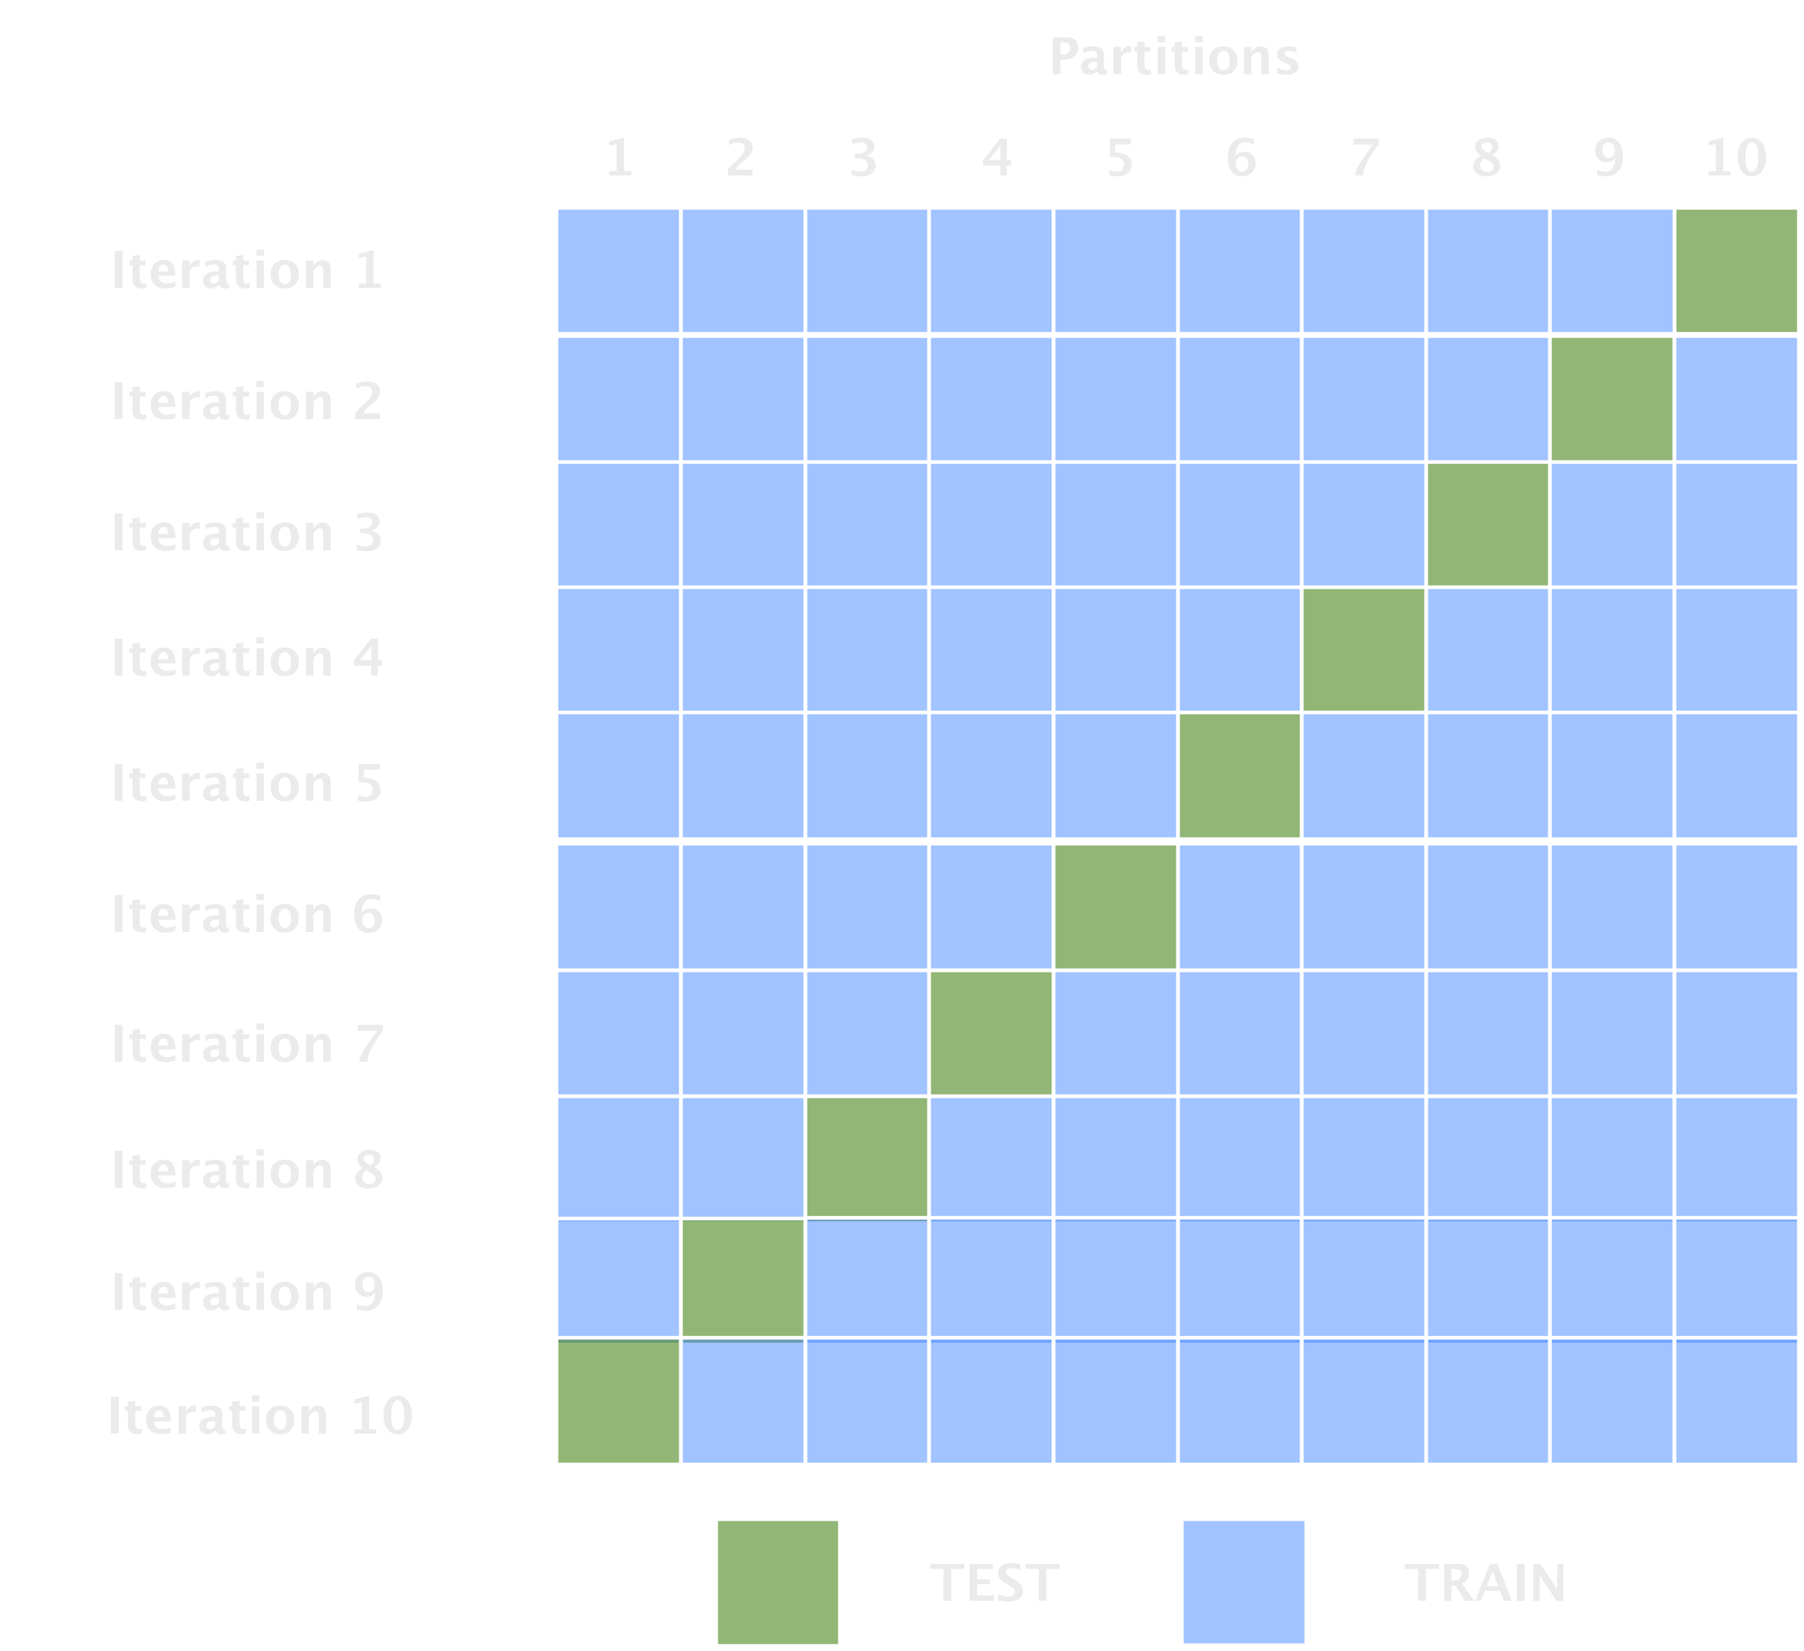
Cross-validation
Notes:
Cross-validation is used for estimating the performance of one set of parameters on unseen data.

Slide 28
Cross-validation
import numpy as np
from sklearn.model_selection import KFold
X = [0, 1, 2, 3, 4, 5, 6, 7, 8, 9, 10]
kf = KFold(n_splits=10)
for train, test in kf.split(X):
print("%s %s" % (train, test))

Slide 29
Cross-validation
[ 2 3 4 5 6 7 8 9 10] [0 1]
[ 0 1 3 4 5 6 7 8 9 10] [2]
[ 0 1 2 4 5 6 7 8 9 10] [3]
[ 0 1 2 3 5 6 7 8 9 10] [4]
[ 0 1 2 3 4 6 7 8 9 10] [5]
[ 0 1 2 3 4 5 7 8 9 10] [6]
[ 0 1 2 3 4 5 6 8 9 10] [7]
[ 0 1 2 3 4 5 6 7 9 10] [8]
[ 0 1 2 3 4 5 6 7 8 10] [9]
[0 1 2 3 4 5 6 7 8 9] [10]

Slide 30
Scikit Only
from sklearn.ensemble import GradientBoostingClassifier #For Classification
from sklearn.ensemble import GradientBoostingRegressor #For Regression
clf = GradientBoostingClassifier(n_estimators=100, learning_rate=1.0, max_depth=1)
clf.fit(X_train, y_train)
Notes:
- n_estimators: It controls the number of weak learners.
- learning_rate:Controls the contribution of weak learners in the final combination. There is a trade-off between learning_rate and n_estimators.
- max_depth: maximum depth of the individual regression estimators. The maximum depth limits the number of nodes in the tree. Tune this parameter for best performance; the best value depends on the interaction of the input variables.

Slide 31
Getting the best results

Slide 32
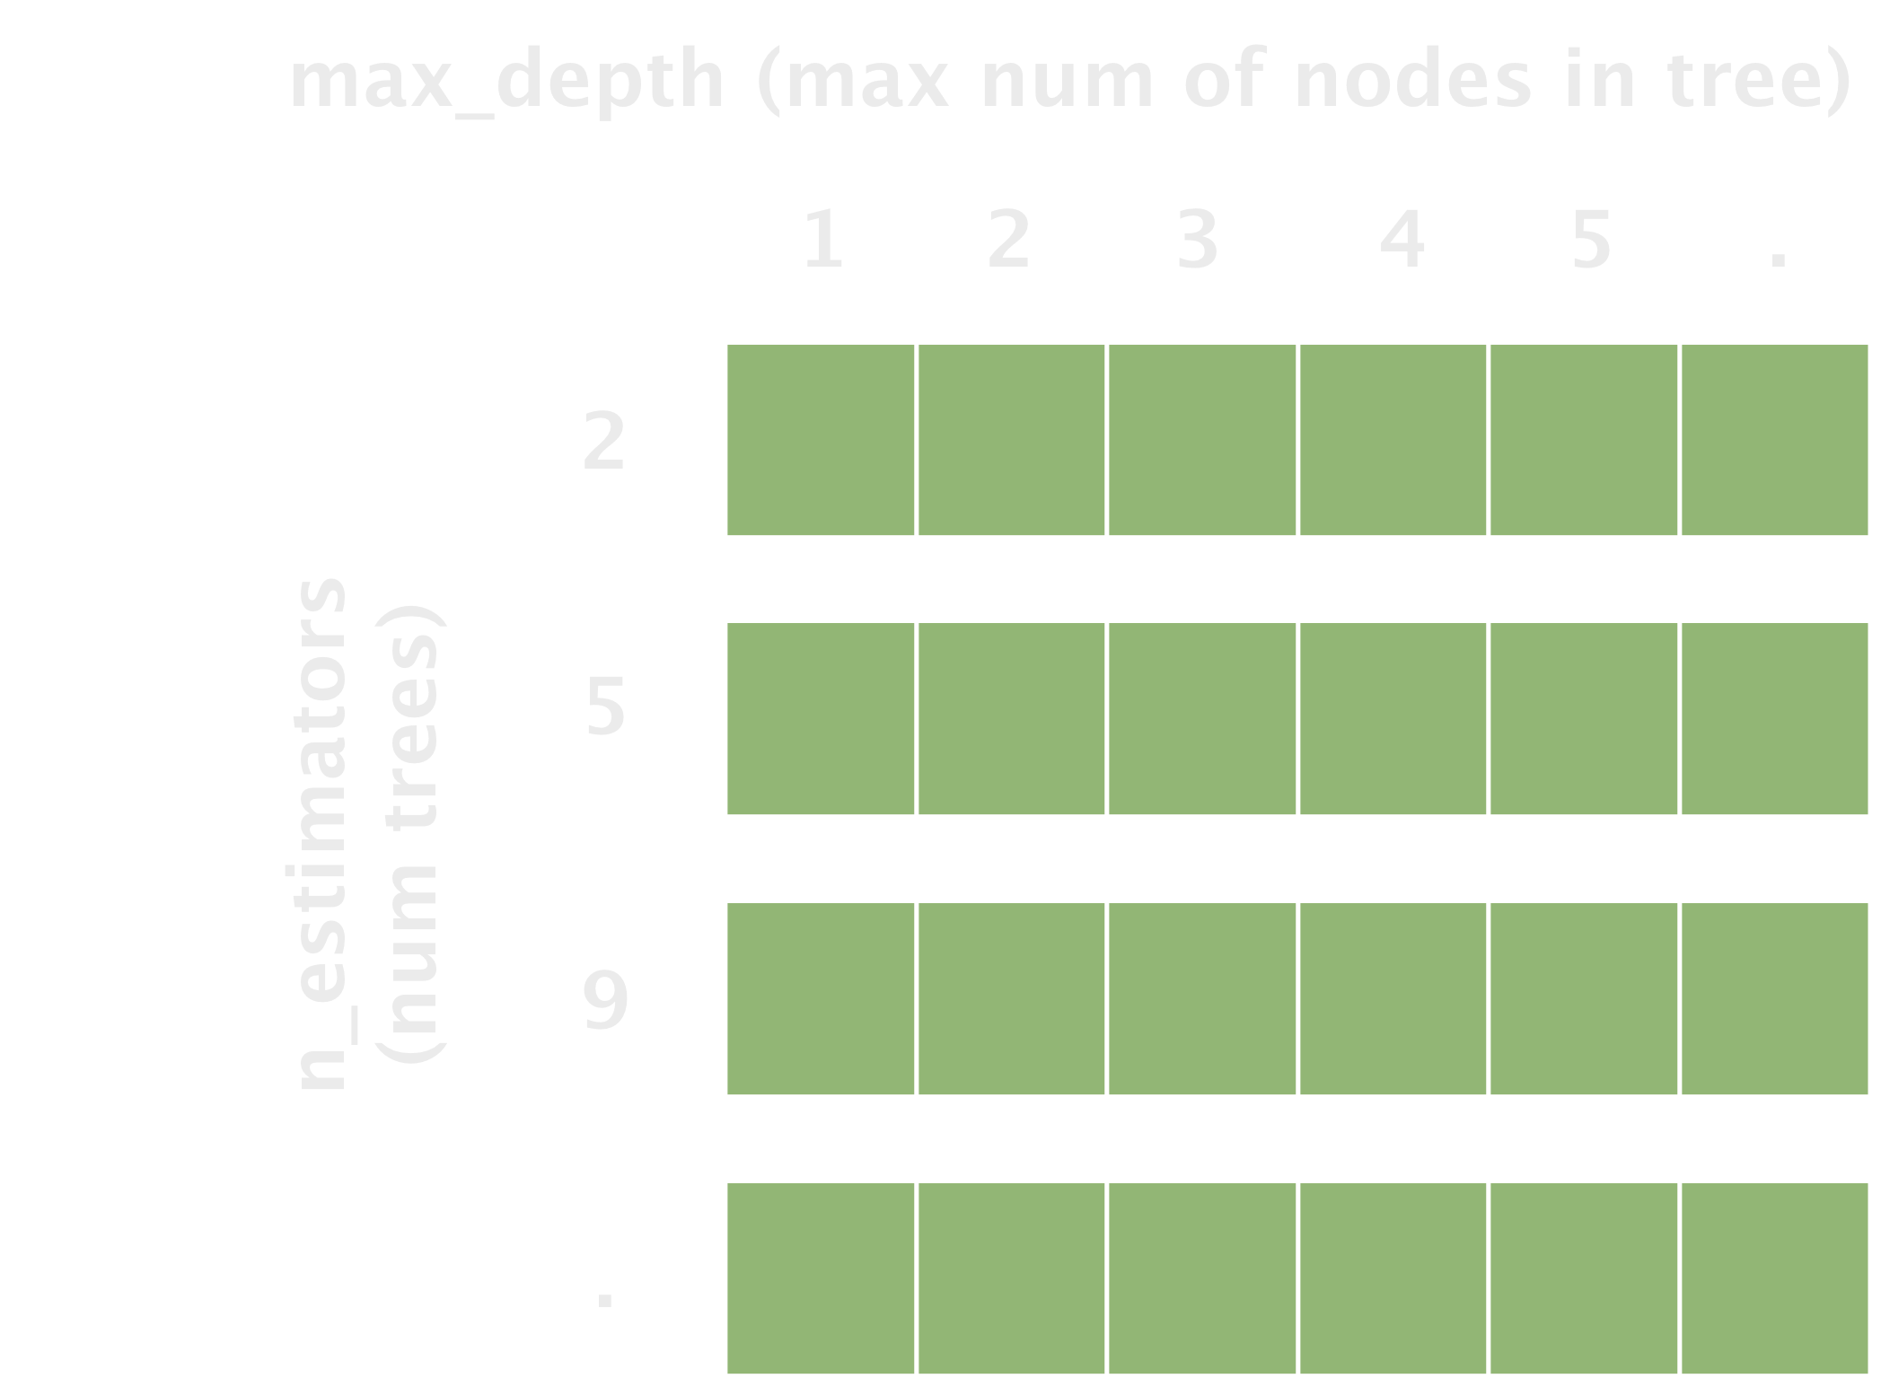
Which Parameters
Notes:
Grid-search evaluates a model with varying parameters to find the best possible combination of these.

Slide 33
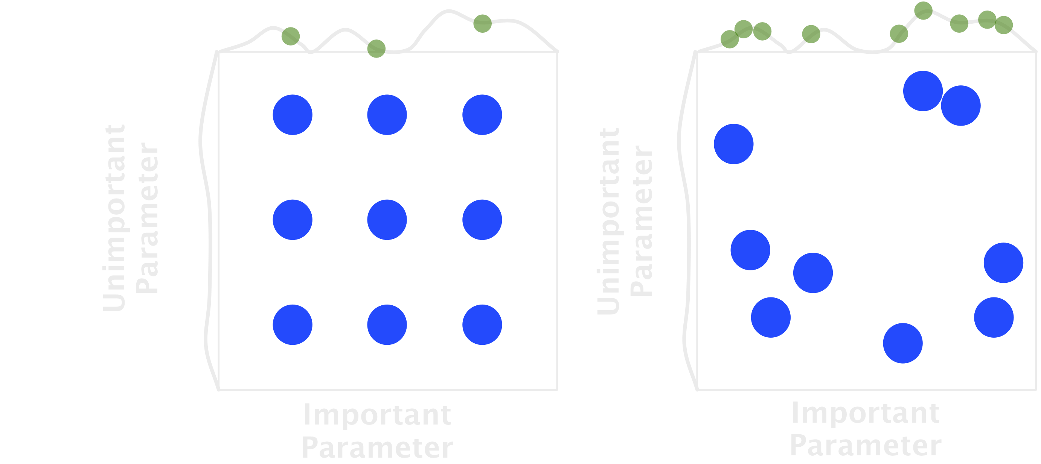
Kinds of Parameter Search
http://blog.kaggle.com/2015/07/16/scikit-learn-video-8-efficiently-searching-for-optimal-tuning-parameters/
Notes:
Grid-search evaluates a model with varying parameters to find the best possible combination of these.

Slide 34
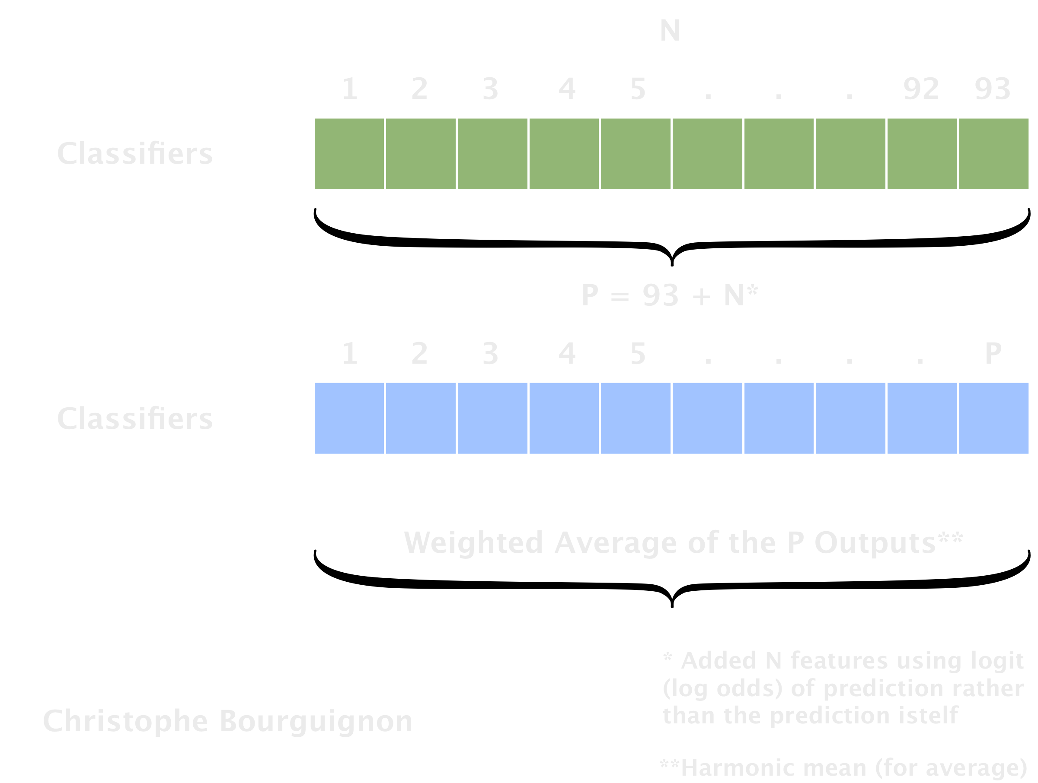
Stacking, Blending, & Averaging
https://medium.com/@chris_bour/6-tricks-i-learned-from-the-otto-kaggle-challenge-a9299378cd61#.3ziqa2hhz
Notes:
They used stacking and started with an initial set of 93 features, new features being the predictions of N different classifiers (Random Forest, GBM, Neural Networks, …). They then retrained P classifiers over the 93 + N features, finally made a weighted average of the P outputs.

Slide 35
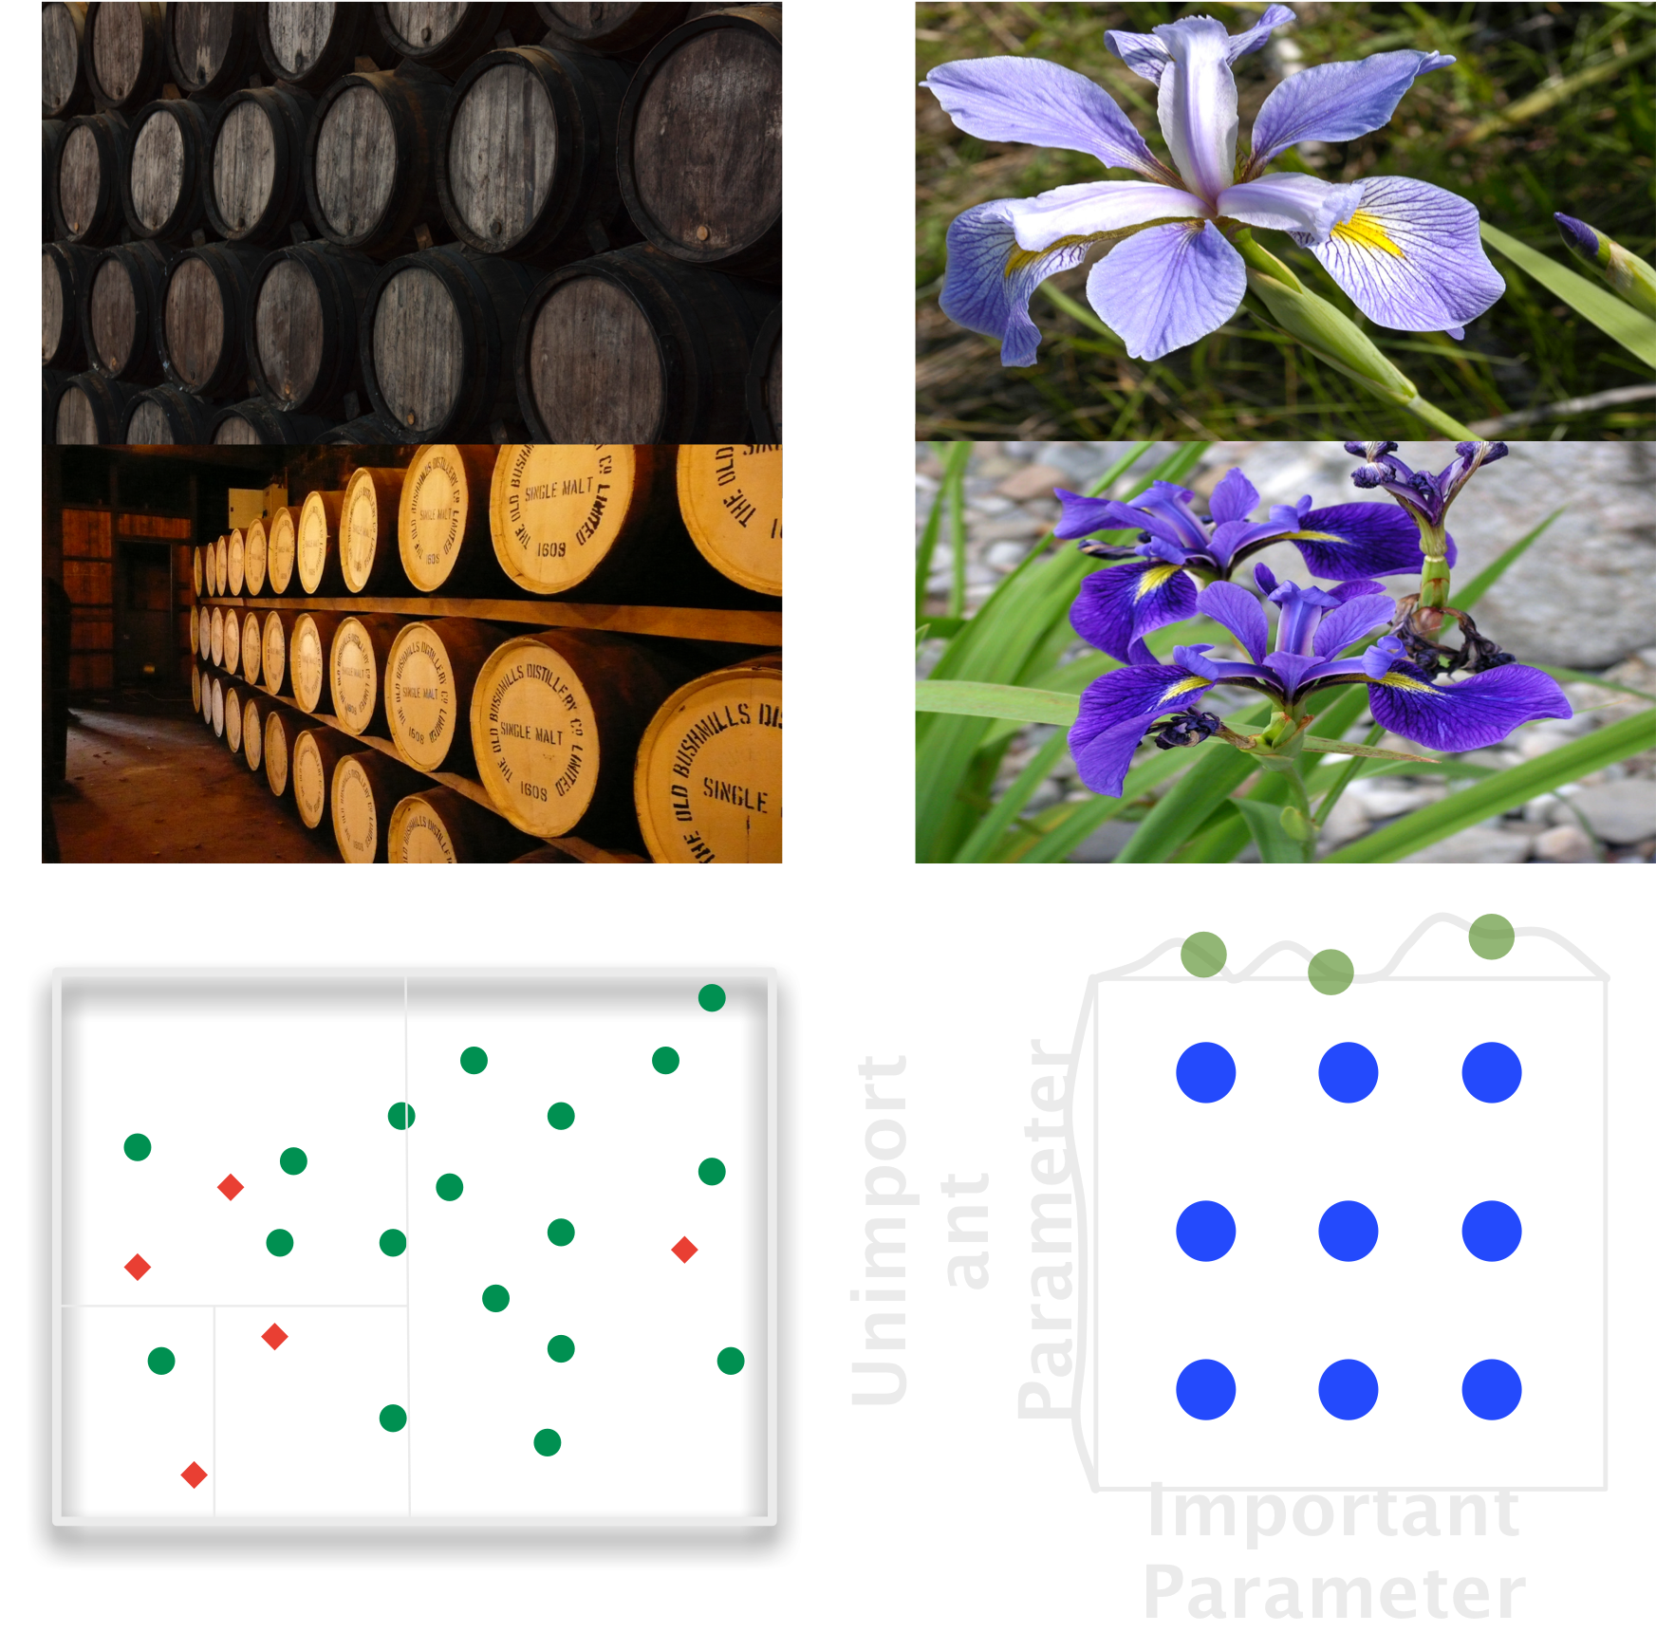
Recap
Notes:
Introduced the types of machine learning, Iris data set, a bit of history and context, gradient descent and gradient boosting, and means of getting best results.

Slide 36
Photo / Image Credits
Yves Cosentino
https://www.flickr.com/photos/31883499@N05/3015866093
Jordi Payà
https://www.flickr.com/photos/arg0s/6705230505/
Matt Nedrich
https://github.com/mattnedrich/GradientDescentExample
Various
https://en.wikipedia.org/wiki/Iris_flower_data_set
Chia Ying Yang
https://www.flickr.com/photos/enixii/17074838535/

Slide 37
Link to Slides & Code
http://github.com/braz/pycon2016_talk/

